Slide 1

Act Locally, Impact Globally

Slide 2
What we have covered so far ?
Lecture 1: Know your data
Types of attributes , MCT , Measure of Dispersion ,Univariate Analysis , Bivariate Analysis
( Based on domain knowledge , you may remove some features here)
Lecture 2: Dealing with Missing Values
Lecture 3: Dealing with Other Data Quality Problems
Incorrect & Obsolete Data , Changing Data Types
Lecture 4: Features Selection

Slide 3

What is Feature Selection ?
Selecting the best set of features which provide most optimal performance in terms of evaluation metric and computational cost.
Removing Redundant Features
Also known as Variable Selection or Variable Subset Selection

Slide 4

Why Feature Selection ?
Not all of the features / columns / variables are important
There may be some features which are not correlated to the class variable
Including Such variables not only complicates the model but may also results in a bad performing model with a high computational cost
So , It is important to identify and eliminate such attributes who do not add to performance but add to computational cost.

Slide 5

Examples
Whether a student will buy a computer may depend on his/her age , gender , financial status and education level , but it does not depend on his /her telephone number .
Whether a patient may acquire cancer may depend on age , gender , smoking history etc but it has no relation with the education level of the patient .

Slide 6

Feature Selection : Core Objective

Slide 7
What we achieve from feature Selection ?
Simplification of Machine Learning Model
Shorter Training Time ( Time to train the model on data)
Avoiding Curse of Dimensionality
Enhanced Generalization
Reduced Overfitting
Notes:
1- Simplification of Machine Learning Model
Too many features make a ML model complex which learns unnecessary detail while too less features make it very simple not able to model the problem at hand properly. We need a relevant set of features which can model the situation with acceptable accuracy and computational cost.
2. Curse of Dimensionality
Curse means the downside and dimensionality means having large number of dimensions in data. When we have very large number of dimensions , it becomes very difficult for data to be available across each dimension resulting in a lot of missing values called data sparsity. This data sparsity creates problems for machine learning algorithms. In an effort to reduce data sparsity , we need to remove the records with a lot of missing values and end up with a dataset that has less number of records as compared to the number of dimensions. In order to achieve statistical significance , an appropriate sample size proportional to the number of dimension is needed which in most of the cases cannot be available.

Slide 8
Curse of Dimensionality
Curse means the downside and dimensionality means having large number of dimensions in data.
When we have very large number of dimensions , it becomes very difficult for data to be available across each dimension resulting in a lot of missing values called data sparsity.
This data sparsity creates problems for machine learning algorithms.
In an effort to reduce data sparsity , we need to remove the records with a lot of missing values
We end up with a dataset that has a smaller number of records as compared to the number of dimensions.
In order to achieve statistical significance , an appropriate sample size proportional to the number of dimension is needed which in most of the cases cannot be available.

Slide 9
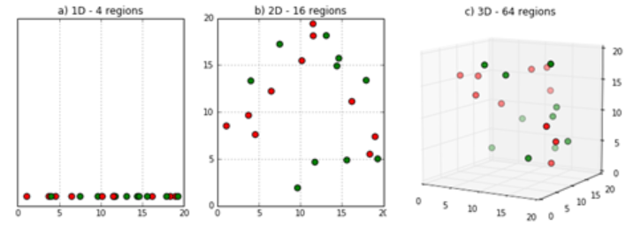
Curse of Dimensionality
Sparsity of data occurs when moving to higher dimensions. the volume of the space represented grows so quickly that the data cannot keep up and thus becomes sparse, as seen below. The sparsity issue is a major one for anyone whose goal has some statistical significance.

Slide 10
Generalization
Generalization refers to how well the concepts learned by a machine learning model apply to specific examples not seen by the model when it was learning.
The goal of a good machine learning model is to generalize well from the training data to any data from the problem domain.
This allows us to make predictions in the future on data the model has never seen.

Slide 11
Overfitting
Overfitting happens when a model learns the detail and noise in the training data to the extent that it negatively impacts the performance of the model on new data.
This means that the noise or random fluctuations in the training data is picked up and learned as concepts by the model.
The problem is that these concepts do not apply to new data and negatively impact the model's ability to generalize.

Slide 12
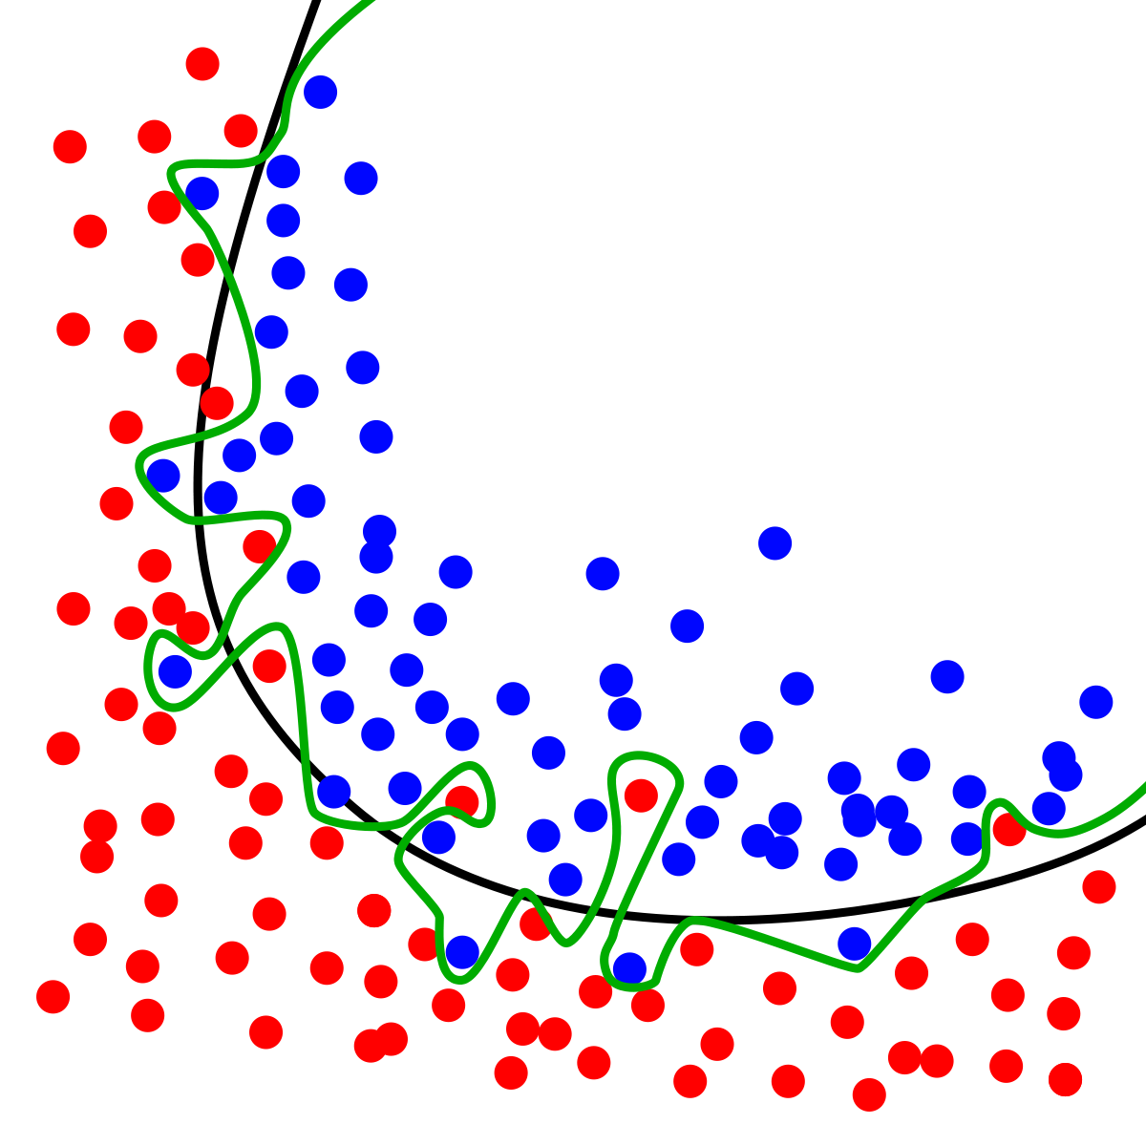
Overfitting vs Generalization

Slide 13
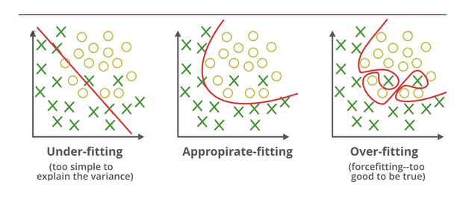
Overfitting

Slide 14
Feature Selection Methods

Slide 15
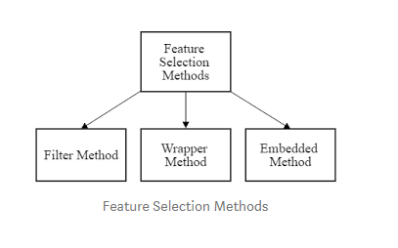
Feature Selection Methods

Slide 16
Filter Methods
Using this method, the predictive power of each individual variable (feature) is evaluated.
Various statistical means can be used to determine predictive power.
One way is by correlating the feature with the target (what we are predicting)
Another way to determine the predictive power is to determine the predictive value of the feature

Slide 17
Filter Methods
For Example :
If Y is target variable and (X1, X2, X3,…Xn) are independent variables.
We find out the correlation between target variable with respect to independent variables.
( Y→ X1) ,(Y →X2),(Y →X3),…(Y →Xn ). So the features which has highest Correlation Feature Selection(CFS) with Y we select that as a best features.

Slide 18

Filter Methods
Feature Selection Using Filter Methods is Independent of the learning algorithm
Feature are selected based on statistical scores

Slide 19
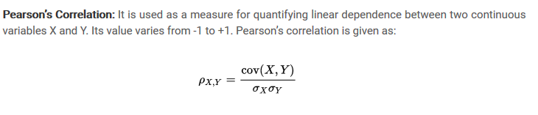
Pearson’s Correlation

Slide 20
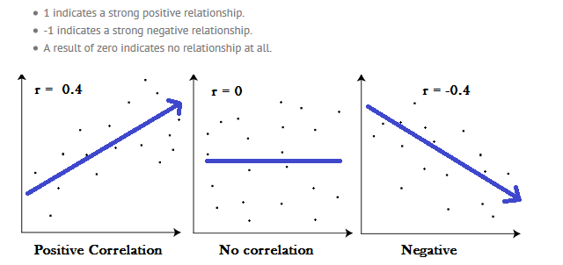
Pearson Correlation Coefficient

Slide 21
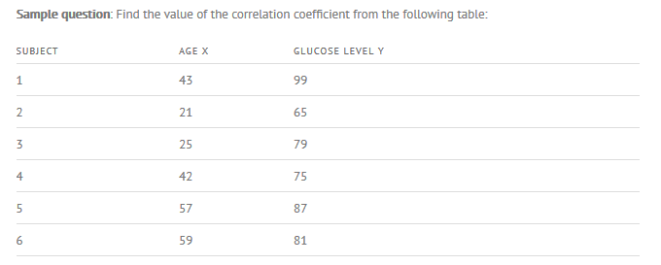
Pearson Correlation Coefficient – Example

Slide 22
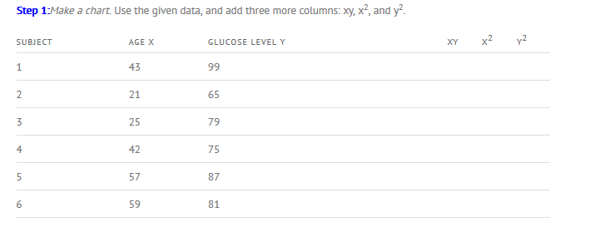
Pearson Correlation Coefficient – Example

Slide 23
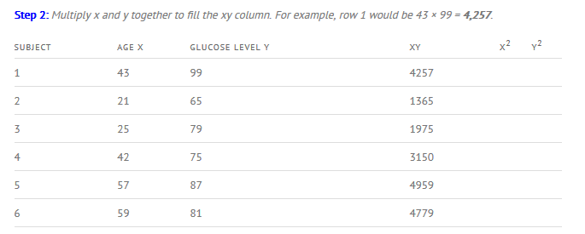
Pearson Correlation Coefficient – Example

Slide 24
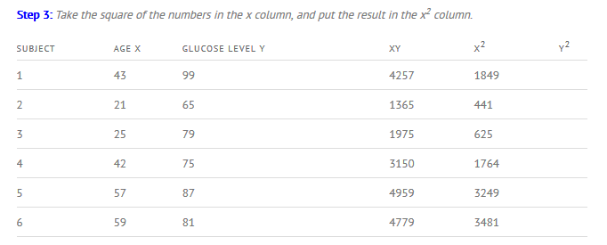
Pearson Correlation Coefficient – Example

Slide 25
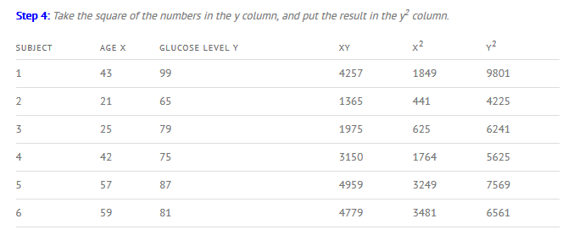
Pearson Correlation Coefficient – Example

Slide 26
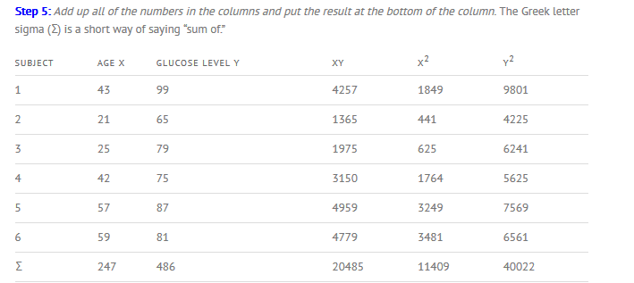
Pearson Correlation Coefficient – Example

Slide 27
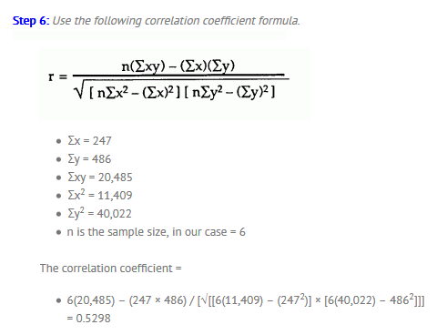
Pearson Correlation Coefficient – Example

Slide 28
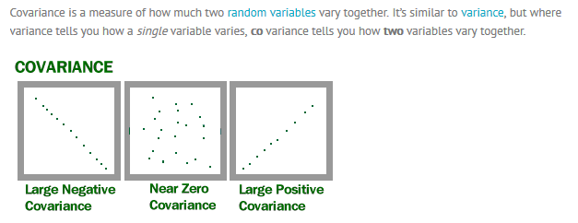
COVARIANCE

Slide 29
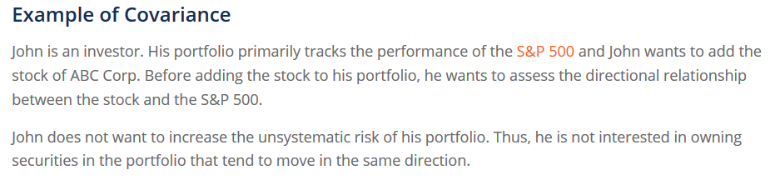
COVARIANCE

Slide 30
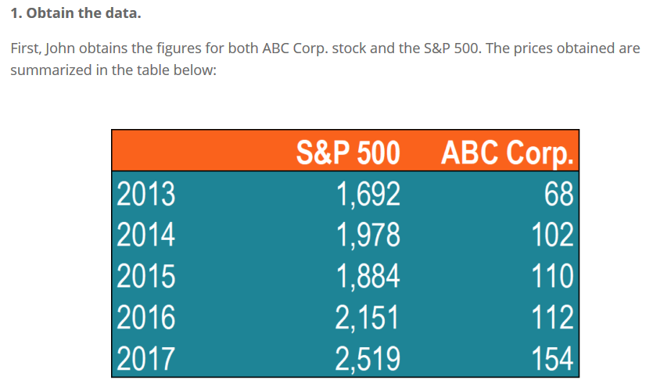
COVARIANCE

Slide 31
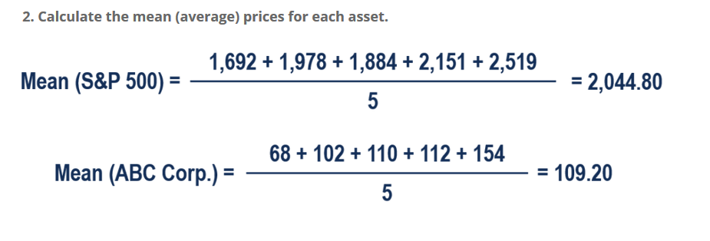
COVARAINCE

Slide 32
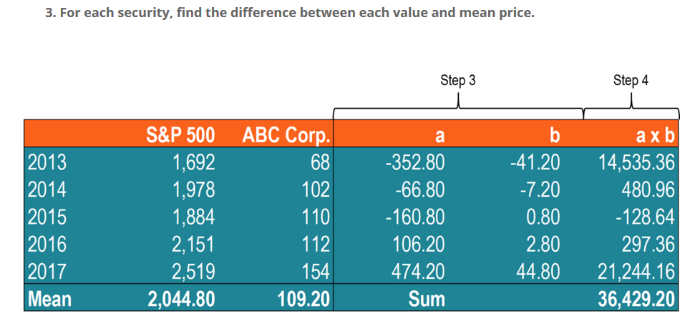
COVARIANCE

Slide 33
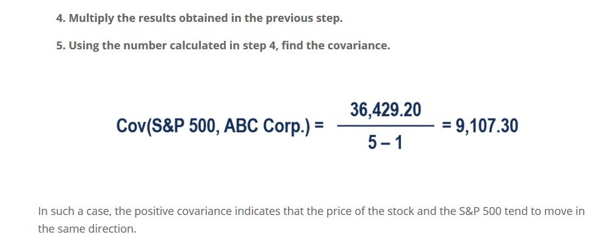
COVARAINCE

Slide 34
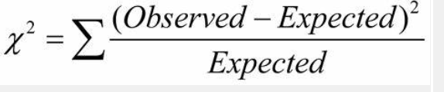
Chi –Square Statistic ( Nominal vs Nominal)
It is a is a statistical test applied to the groups of categorical features to evaluate the likelihood of correlation or association between them using their frequency distribution.
Observed Frequency means actual count
Expected Count = Count( A=ai) * Count (B=bj) / n

Slide 35
Example
A group of 1500 people ( male / female) was surveyed ( n=1500), whether they like fiction or non-fiction reading.
We have two categorical variables namely gender & preferred_reading
The contingency table gives the counts in each category
 | Male | Female | Total
Fiction | 250 | 200 | 450
Non-Fiction | 50 | 1000 | 1050
 | 300 | 1200 | 1500

Slide 36
Chi Square – Example
Expected Frequencies
Expected Frequencies :
E11=count (male) *count(fiction)/n = 300 *450 / 1500 =90
E12= count(male ) *count(non-fiction) /n= 300 *1050/1500=210
 | Male | Female | Total
Fiction | 250 (90) | 200 (360) | 450
Non-Fiction | 50 (210) | 1000 (840) | 1050
 | 300 | 1200 | 1500

Slide 37
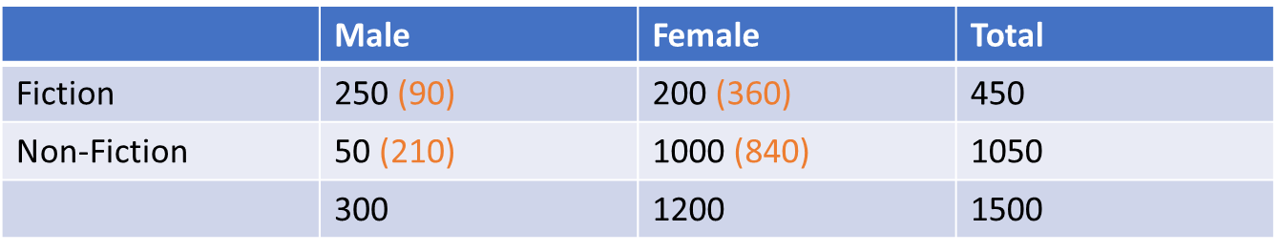
Chi Square Example
Now Compute Chi Square statistic using below formula:
Chi Square = ( 250-90)² /90 + (50-210)²/210 +(200-360)²/360 + (1000-840)²/840
= 507.93

Slide 38
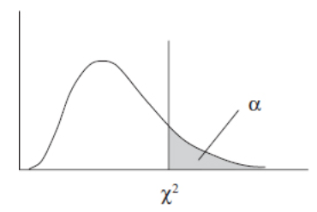
Question : Are Gender and Preferred_reading co-related ?
For a 2 X 2 contingency table there are (2-1) X(2-1) = 1 Degrees of Freedom.
Null Hypothesis H0: Both Gender and Reading Style are independent
Alternative Hypothesis H1: There is an association or relationship between Gender and Reading Style
Significance Level = 5%
Tabulated value for 1 df and 5% significance level is : 3.84 ( Critical value)
As computed value ( 507.93) > ( Tabulated values = 3.84) we can reject the Null Hypothesis and conclude that both variables are strongly correlated.

Slide 39
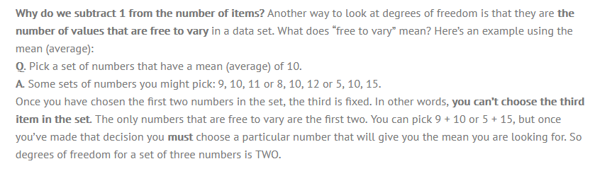

Slide 40


Definitions

Slide 41
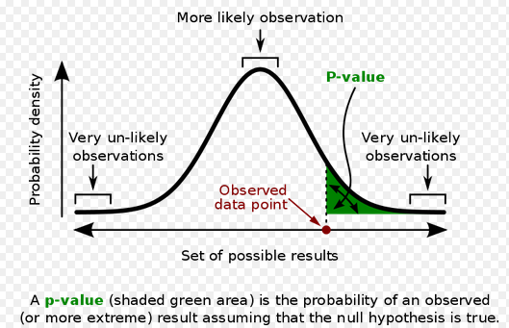
p- value
Video Link for P value calculation

Slide 42
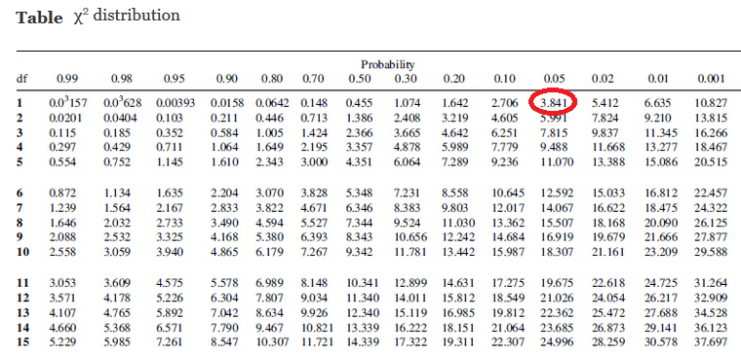
Chi Square Distribution Table

Slide 43
Hands On :https://archive.ics.uci.edu/ml/datasets/Bank+Marketing#

Slide 44
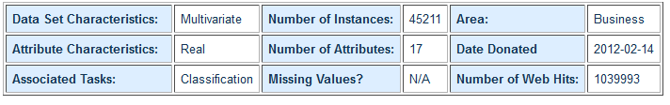
Dataset : Bank Marketing Dataset
Abstract: The data is related with direct marketing campaigns (phone calls) of a Portuguese banking institution. The classification goal is to predict if the client will subscribe a term deposit (variable y).

Slide 45
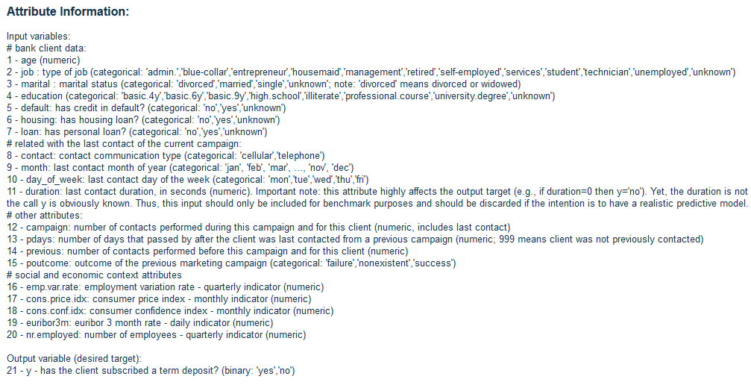
Financial Marketing Dataset

Slide 46
Hands-On
Download the dataset from the Link
Use Chi –Square to check association between categorical class and all other categorical variables
Use Pearson Correlation Coefficient to check strength of correlation between all continuous ( Independent Variables) and the quantitative class variable

